Slide 1
Lead Scoring Case Study
Logistic Regression

Slide 2
Problem Statement
Business Objectives
X Education sells online courses to industry professionals.
Although X Education gets a lot of leads, its lead conversion rate is very poor. The typical lead conversion rate at X education is around 30%.
To make this process more efficient, the company wishes to identify the potential leads, also known as ‘Hot Leads’.
If they successfully identify this set of leads, the lead conversion rate should go up as the sales team will now be focusing more on communicating with the potential leads rather than making calls to everyone
X Education wants to identify the most promising leads.
The company wants to build a model to identify the hot leads.
Improve the lead conversion rate from 30% to 80%

Slide 3
Solution Methodology
Reading and Understanding Data
Data Cleaning
Handle missing data
Handle Skewed Categorical Columns
Handle Outliers
EDA
Univariate Analysis of Categorical Columns w.r.t. Target Variable
Bivariate Analysis of Numerical Columns
Data Preparation
Dummy Variable Creation
Test and Train Split of the data
Scaling
Modelling
Model Validation and Evaluation
Conclusion

Slide 4
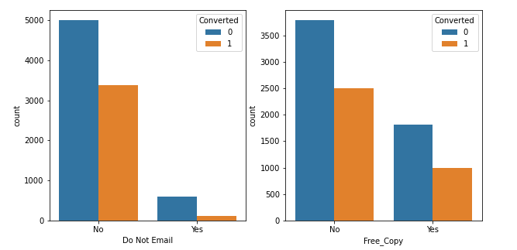
EDA
Most of the leads do not want to be emailed about the course and also do not want the free copy of mastering the interview.
Those leads who do not want to be emailed have high chances of getting converted.

Slide 5
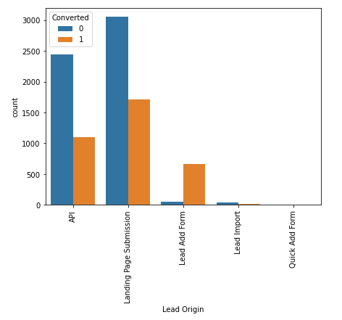
EDA
API and Landing Page Submission bring higher number of leads as well as conversion.
Lead Add Form has a very high conversion rate but count of leads are not very high.
In order to improve overall lead conversion rate, we need to improve lead conversion of API and Landing Page Submission origin and generate more leads from Lead Add Form.

Slide 6
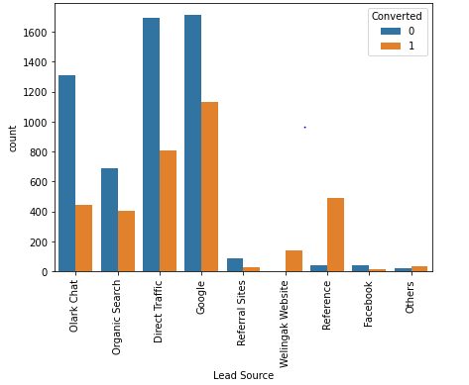
EDA
Reference and Welingak Website have very high conversion rate but count of leads are not very high.
Google, Direct Traffic and Olark Chat bring higher number of leads as well as conversion.

Slide 7
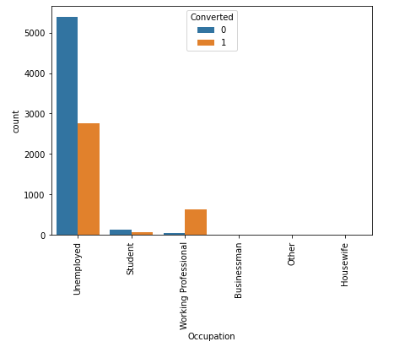
EDA
Working professional checking about the course have high chances of joining the course.
Higher number of leads as well as conversion from Unemployed category.

Slide 8
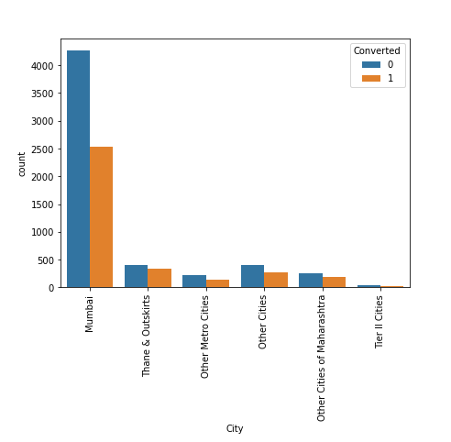
EDA
Mumbai has the highest number of leads as well as conversion.

Slide 9
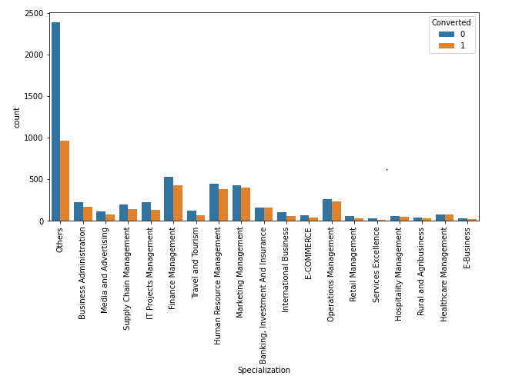
EDA
Highest number of leads as well as conversion fall in 'Others' category. However, this category is the bucket of 'Not Specified' Values.
Finance Management, Human Resource Management, Marketing Management, Operations Management are showing reasonably good results in terms of count of leads as well as conversion.

Slide 10
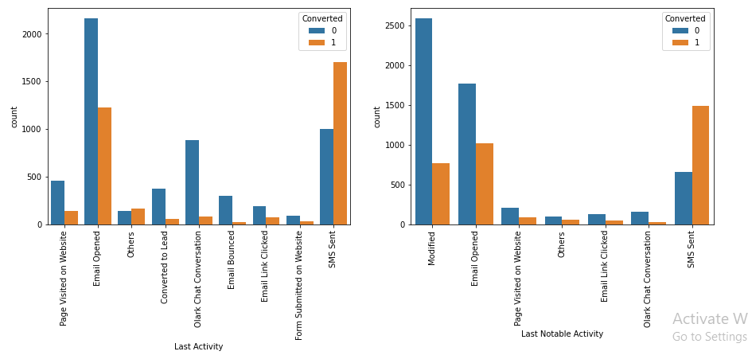
EDA
For Last Activity, although the count is high for 'Email Opened', but the highest conversion rate from 'SMS Sent' Category.
For Last Notable Activity high Conversion rate is for 'Email Opened' and 'SMS Sent' Category.
For Last Notable Activity lead count is highest for 'Modified' and 'Email Opened' category.

Slide 11
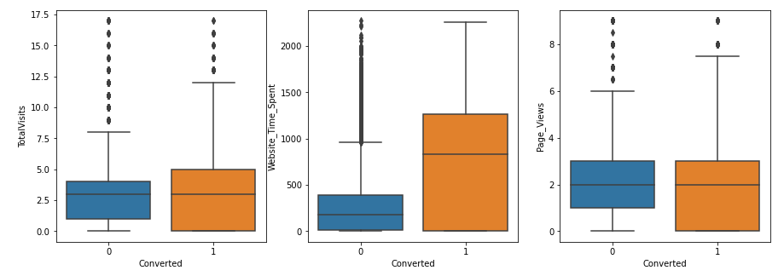
EDA
Leads spending more time on the website are more likely to be converted.

Slide 12
Data Preparation
Dummy Variables were created for the Categorical Columns
Train – Test Split was done for a ratio of 70:30
After above operation total number for row and columns were 9239 and 60 respectively

Slide 13
Modelling
Logistic Regression model was implemented for this.
Implemented RFE for 15 important variables
Applied manual method for dropping variables considering p-value and VIF.
Built around 5 models in total. Used 5th model as it had very low P values .VIF values were also under acceptable limits.¶
Model Evaluation was done using accuracy, sensitivity and specificity.
Used ROC to check the trade off between True Positive Rate and False Positive Rate.
Found the Optimal Cut-off point to improve sensitivity.

Slide 14
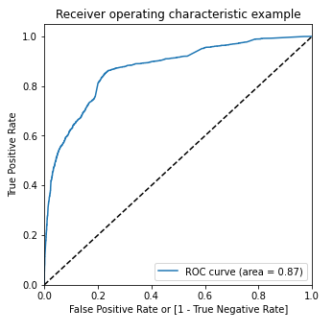
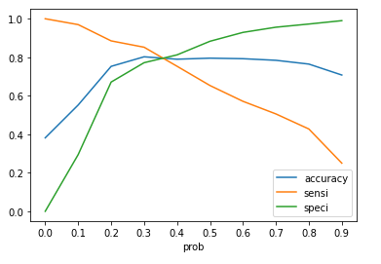
ROC and Optimal Cut off Point
Area under ROC is 0.87, which is a very good value for a model.
From the curve above, 0.35 is the optimum point to take it as a cutoff probability.

Slide 15
Conclusion
Variables that mattered most in the lead conversion are:
Website_Time_Spent with an coefficient of 0.9222
Lead Origin_Lead Add Form with an coefficient of 3.8048
Occupation_Working Professional with an coefficient of 2.6938
The ability of accurately predicting the conversion rate of any lead from the model is around 80%.
The probability of predicting a promising lead from the model is around 82%.
The model seems to predict the Lead Conversion Rate very well. It should be able to give the CEO confidence in making good calls based on this model
 | Train Set | Test Set
Accuracy | 80.43 | 80.08
Sensitivity | 83.07 | 82.38
Specificity | 78.80 | 78.61

Slide 16
Recommendation
X Education must focus on the people if –
The lead origin is through Lead Add Form
The prospect is a working professional
The prospect spends a lot of time on the website
As these parameters have positive coefficients, this will improve the lead score and in turn, these people will be ‘hot leads’ for X Education
Other important Variable that can be looked into
Do Not Email
Last Activity_Email Bounced
Last Activity_Olark Chat Conversation
Last Notable Activity_Email Link Clicked
Last Notable Activity_Email Opened
Last Notable Activity_Modified
Last Notable Activity_Olark Chat Conversation
Last Notable Activity_Page Visited on Website

